Slide 1
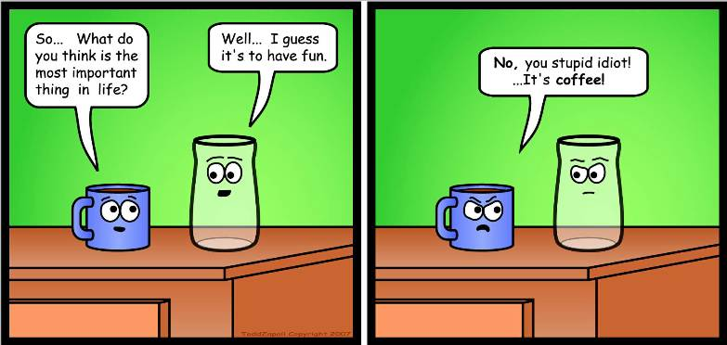
Object-Oriented Design
http://www.flickr.com/photos/digitalcolony/2725932075/sizes/o/

Slide 2
Why is that joke supposed to be funny?
Objects and concerns
Objects have a concern in the sense that they have a purpose.
Which is not to say that inanimate objects are concerned in the sense of being worried.
Likewise, all code should have a concern, a purpose for being.
A place for every concern…
and every concern in its place.

Slide 3
Concerns of classes
Each class should have a clearly focused purpose.
One class usually corresponds to one kind of entity
Each class member usually corresponds to one attribute
Only code related to that purpose should be in the class.
Put functions together with the data that they modify.
Put code together if it needs to be modified at the same time.

Slide 4
Concerns of packages
Ditto for packages
Every package should have a purpose
Code should be in that package if and only if it is related to that purpose
“Module” or “component” can refer to a class or to a package
Every module should have a purpose
Code should be in module if and only if related to that purpose

Slide 5
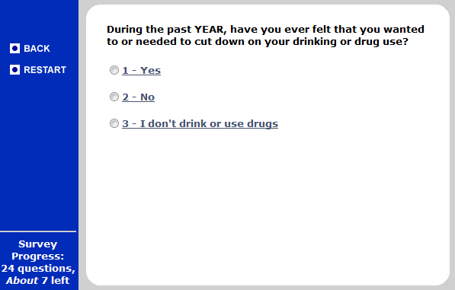
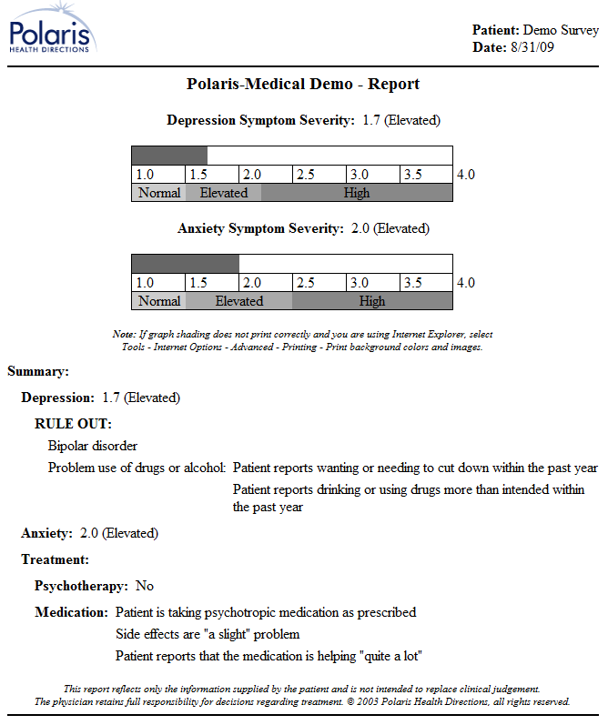
An example system to support drug and alcohol counseling
http://cf.polarishealth.com/demo/start_demo.html

Slide 6
What are the key concerns?
Last name & PIN
Authenticate
Counselee
User ID
Health Information
admnister
Survey
Survey answers
Survey DB
All this patient’s answers (ever)
Counselor
Printout
Postscript
Create report
Printer

Slide 7
Some key concerns
Managing the users
Authenticating counselees
Matching counselees to counselors
Performing the survey
Representing the questions
Representing the answers
Performing skip logic
Storing the answers
Generating the report
Reading the data
Performing calculations in the report
Sending to the printer

Slide 8
Assigning concerns to code
Authenticator
Survey Server
Counselee Rec.
Question loader
Skip logic module
Counselor Rec.
Answer storer
Survey Instance
Questions
Report Maker
Data loader
Answers
Calculation module
Printer controller

Slide 9
Notes about UML class diagrams
One box per kind of entity
Usually list attributes
Interfaces & abstract attributes italicized
Lines without arrowheads show references
Represents member variables in OO
Labeled with cardinality (multiplicity)
Lines with open arrowheads for specialization
Lines with regular arrowheads indicate dependencies
I’m omitting several pieces of the diagrams today, to make the diagrams less cluttered so that you can focus on today’s lessons.

Slide 10
Coupling and cohesion
Coupling
When one module is involved in another module’s concern
Cohesion
When a module is devoted to its concern

Slide 11
Coupling reduces maintainability
Levels of coupling
Content coupling (worst)
A modifies B
Common coupling
A and B both read/write the same data
Control coupling
A calls B
Stamp coupling
A provides structured data to B
Data coupling
A provides unstructured data to B
Uncoupled (best)
None of the above
If A and B are coupled, then modifying A may require modifying B.

Slide 12
Inter-package coupling
Authenticator
Authenticator
Survey Server
Survey server
Data Records
Counselee Rec.
Question loader
Skip logic module
Counselor Rec.
Answer storer
Survey Instance
Report Maker
Questions
Report Maker
Data loader
Answers
Calculation module
Printer controller

Slide 13
Cohesion increases maintainability
Levels of cohesion
Functional/informational cohesion (best)
A and B work together for just one purpose
Communicational cohesion
A and B use the same data
Procedural cohesion
A executes, then B executes, and A & B have vaguely related purpose
Temporal cohesion
A executes, then B executes, but A & B do not have any related purpose
Logical cohesion
Either A or B might be executed
Coincidental cohesion (worst)
None of the above
If A & B are together in a larger component that is highly cohesive, then it is easy to find the code for a concern.

Slide 14
Intra-package cohesion
Authenticator
Survey Server
Counselee Rec.
Question loader
Skip logic module
Counselor Rec.
Answer storer
Survey Instance
Questions
Report Maker
Data loader
Answers
Calculation module
Printer controller

Slide 15
Tip #1: Don’t talk to strangers (“Law of Demeter”)
Authenticator
Survey Server
Counselee Rec.
Question loader
Skip logic module
Counselor Rec.
Answer storer
Survey Instance
Questions
Report Maker
Data loader
Answers
Calculation module
This would be bad:
Printer controller

Slide 16
Tip #2: Move code to where it’s used
Authenticator
Survey Server
Counselee Rec.
Question loader
Skip logic module
Counselor Rec.
Answer storer
Survey Instance
Report Maker
Questions
Data loader
Answers
Calculation module
Reducing inter- package coupling.
Printer controller

Slide 17
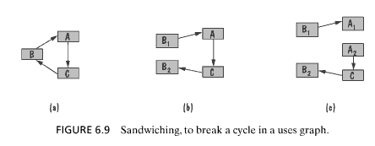
Tip #3: Split modules to reduce cycles
That design had no cycles
But here’s one way to get rid of cycles when they do happen to occur…
Pfleeger & Atlee

Slide 18
Tip #4: In reuse, prefer composition over inheritance
In general, use composition to add features or to reuse code, and use inheritance to add a new version of an entity.
Survey Server
Survey Instance
Question loader
Questions
Skip logic module
Answers
Answer storer
Timing data
Answer cross-check
Logging module

Slide 19
Tip #4: In reuse, prefer composition over inheritance
In general, use composition to add features or to reuse code, and use inheritance to add a new version of an entity.
Survey Instance
Report Maker
Data loader
Questions
Answers
Calculation module
Numeric question
Numeric answer
Printer controller
Multiple choice ques.
Multiple choice ans.
Free-text question
Free-text answer
Physical printer ctrllr.
Printout-by-email ctrllr.
Printout-by-web ctrllr.

Slide 20
The secret to using interfaces
An interface is a promise
I can provide this output if you provide a valid input.
If you meet these preconditions, then I can meet these postconditions.

Slide 21
Incremental and iterative development
Use incremental development
When much of the system’s value resides in one subsection
When one part of the system must be completed (logically) before another
Use iterative development
When the system’s value is spread out over much of the system
When the whole system needs to work at least a bit before you can build up

Slide 22
Incremental and iterative development
Incremental examples
Adding new kinds of print outs
From customers’ standpoint, paper printout carried much of the system’s value
Adding a new data export module
Logically, the main system needs to be done before we can worry about exporting data.
Iterative examples
Tweaking reports and surveyor user interface to improve usability
Improvements to existing pieces of system
Adding new kinds of questions (and answers), changing reports accordingly
Changes are spread across system

Slide 23
What’s next for you?
You know the drill about working on the homework.
H3 due this Saturday
Keep updating your vision statement.
You have received feedback on V2

